Slide 1
The Reuse and Evolution of Component Frameworks
Andrew McVeigh, 3rd October 2005

Slide 2
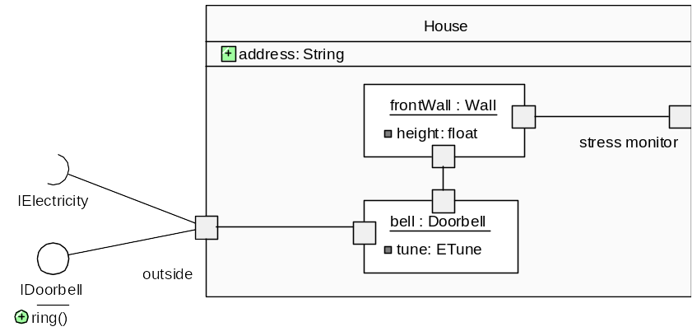
UML2 & Components
UML2 grafted a full ADL into the UML language
  UML1.x had very poor support for this
A component is a “replaceable part of a system that provides the realization of a set of interfaces” [Booch, 2005]
  Ports are a “window on a component”: provided and required interfaces
  Components are “composed” of other component instances (parts)
  Leads to a hierarchy of components and parts
  Have configurable properties
  A connector is a “wire” which joins ports
UML2 component diagram
Component hierarchy diagram
House
Wall
Doorbell

Slide 3
Component Frameworks
A framework is [Booch, 2005]
  “...an extensible template for applications within a domain”
  A micro-architecture encompassing a set of mechanisms and abstractions that work together to solve a common problem for a domain
Frameworks are perhaps the most effective form of reuse
  Frameworks are often active, with control patterns encoded within
  Component instances must be “plugged into” the framework
  The framework may dispatch out to these plugins (Hollywood principle)
  Frameworks are usually layered on other frameworks
  A framework can be structured as a component
  Most of the problem for an app is solved. Just needs to be extended.
  App developers are not the same as the framework developers
Most extensible component systems have frameworks at their core
  Eclipse, Poseidon UML, Affina at DataCard, QARisk at Barcap, operating systems...
  Main goal is to allow third party developers to extend functionality, but benefit from the extensive mechanisms already in place

Slide 4
Problems with Reusing and Evolving Frameworks

Slide 5
Evolution Issues
A framework will be used by multiple app teams
All apps need extra facilities and abstractions from the framework
  Places pressure on framework to add these for one app
  How can we avoid introducing app-specific abstractions into framework?
  How can we avoid breaking all other clients when evolving framework?
  How can we prevent code forking? (bad, but it’s often easier to fork)
Very common situation. E.g. in Eclipse...
  Upgrade of features will break many plugins
  Plugin/app writers must wait a long time for new features / plugin points
  For a plugin writer to upgrade the framework means forking it (= very bad)
  Multiple plugins generally don’t work well together
…..
app1
app2
app3
appN
framework

Slide 6
Abstraction and Layering Issues
Frameworks are often layered on other frameworks
  The top layer and its parameters will be exposed to the app developer
  The layers under this are usually hidden
  The upper layers have higher level abstractions
  The developer cannot alter or adjust the lower level abstractions
Related to the abstraction problem [Greenfield, 2004]
  The higher level abstractions are built on the lower-level ones
  As the level goes up, fine grained customisation of the provided facilities becomes more difficult
  lower-level frameworks and abstractions get “buried”
application
framework3
framework2
framework1

Slide 7
Variability Issues
Framework is limited by the variability that has been designed in
  Usually a feature analysis is done before building, these eventually end up as some sort of “plugin” points allowing extension
  Introduction of new concepts can be difficult, as the architecture may not support the new features well
  “Plugin” points cannot be added without changing the source code of the framework

Slide 8
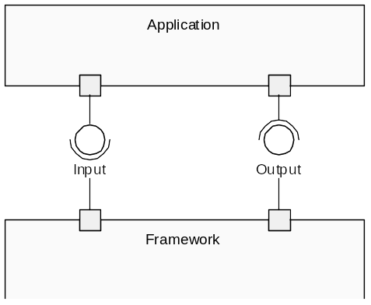
Typing & Substitution Issues
Static typing is usually needed for comprehension, but causes problems
  frameworks work with base types, but apps can’t be passed the full type back
Full substitutability is also a problem
  What if framework doesn’t use all of the IPrinter methods?
  Unnecessarily limits reusability
3
Framework must pass back IPrinter interface
to the application, and the app must
“downcast”.
1
Framework understands IPrinter, say, and
application can pass in LaserPrinter
via the Input interface
Framework works with the IPrinter interface
2

Slide 9
UML2, Backbone & Component Redefinition
Addressing the Issues with Framework Reuse and Evolution

Slide 10
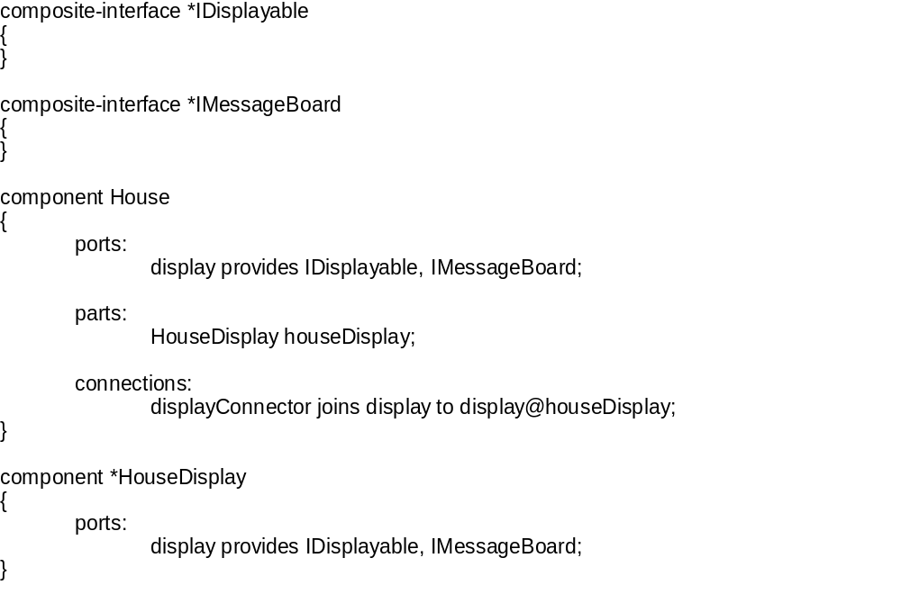
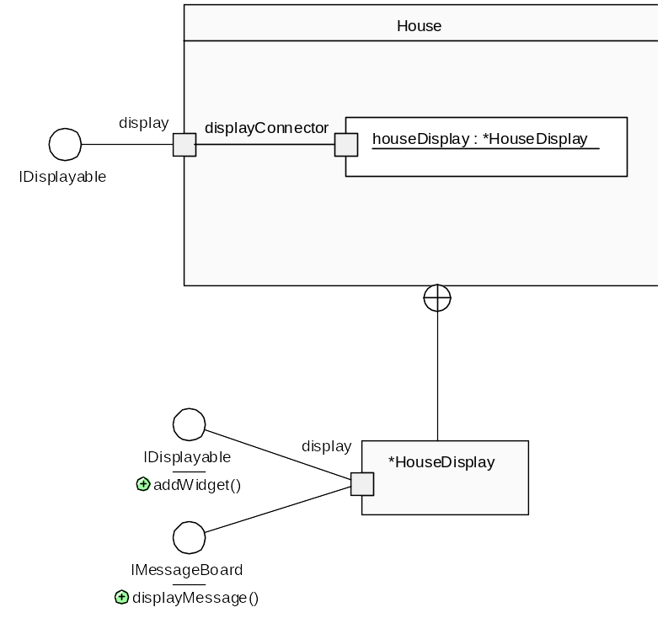
UML2 as an ADL
Backbone is just the UML2 component model in textual form
  Aim to eventually hide this fully by a graphical UML representation
  Uses the UML2 meta-model
  NOTE: all features are explicitly named

Slide 11
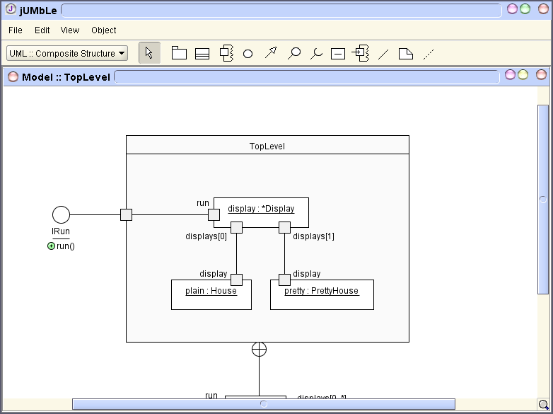
The Backbone Approach
The interpreter instantiates components to produce a running system
The architecture is explicit and more understandable as a result
But it isn’t enough
  We haven’t solve any issues to do with reuse or evolution…
  The framework team would want to control the component definitions
.bb
Java implementation
(jar files)
.bb
.bb
Backbone
interpreter
= running program

Slide 12
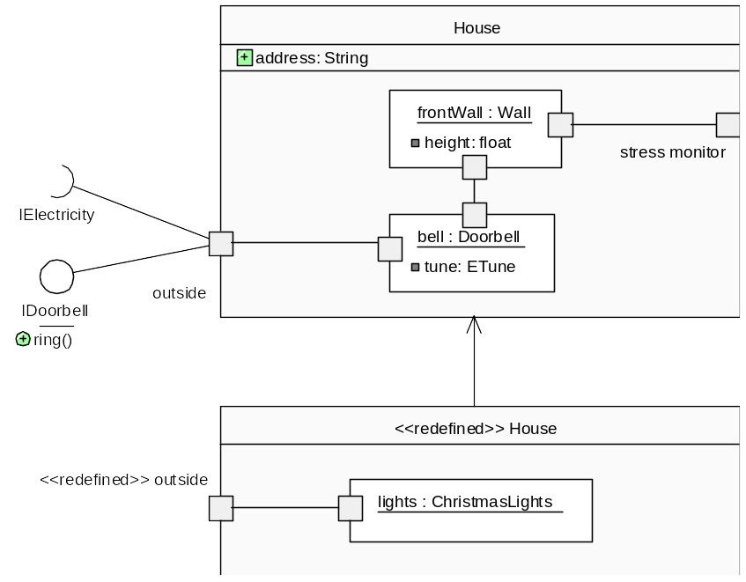
Introducing Redefinition
A component redefinition is a way of expressing changes to an existing component (in terms of adding and removing features)
  e.g. like a set of instructions expressing changes
  the redefinition is kept separate from the definition
House.bb
component House
{
…etc…
RedefinedHouse.bb
redefine-component House
{
part:
ChristmasLights lights;
connections:
lightConnector joins
plug@lights to outside;
}

Slide 13
Redefinition continued...
The changes to a component are kept separately from the definition of that component, but can be applied to the architecture
E.g. scenario where framework provides a House with just a doorbell, and app developer want to make it so that all Houses have lights also…
App2 will not see the changes that App1 made, even though they have affected App1’s version of the framework
App1 developer can introduce arbitrary changes to the structural model of the framework
App1 is still using the original framework, without forking code...
App1
App2
RedefinedHouse.bb
House framework
House.bb

Slide 14
Redefinition continued...
Redefinitions are applied according to ordering rules, allowing another redefinition to redefine an already redefined component
Arbitrary structural changes are possible
Deletion, addition and replacement are possible for parts, properties, ports, interfaces and connections
It is possible to make deep and fundamental changes to an architecture, or merge two frameworks
The mechanism can also be used as a form of structural inheritance
(is-like). E.g. component NewHouse is-like House...
Example scenario:
  a complex system is delivered with a fixed set of extension points
  the app developer can see and change any part of the architecture to suit their needs, without seeing the implementation code
  making these changes does not mean that they are now responsible for the entire framework (as it would if they had forked the code)

Slide 15
Issues with Redefinition
The graphical syntax needs work
  The textual syntax is simpler
Evolution must be supported
  Need a way of checking that redefinitions still work after a framework has been evolved
  Need a way to ensure that independently developed plugins / apps will work together, or to detect incompatibility
  Need a way to handle evolution of interface methods / types
  Control issues. How do we change the way that a framework expects control?
Is this related to refactoring?
  Are redefinitions an example of architectural refactoring instructions?
  What are the vectors of architectural evolution?

Slide 16
Summary
Reuse and Evolution are related topics!
  Reuse often means evolving an architecture
  Reuse of a framework places constraints on how it can evolve
Frameworks are a vital structure for reuse, but...
  Reuse is currently limited by the in-built variability provided by a framework
  Reuse often means compromising the integrity of the framework
Component redefinition allows changes to an architecture to be expressed independently from the architecture itself
  The changes and the original definition are both preserved
  Forms a compelling model for framework architectures, allowing app developers to reuse a framework in more situations
Redefinition must be extended
  Checks & better primitives needed
  More than just structure? Control, behaviour, types?

Slide 17
Appendix A: jUMbLe and Backbone

Slide 18
jUMbLe
A case tool with an internal component architecture (50kloc)
Aim is to draw the entire architecture using UML2 component diagrams, and generate the Backbone source completely from the diagrams
Structure of jUMbLe has been design to cope with performance model of Backbone
Status: can draw the diagrams, need to tie to full UML2 model and write Backbone generator
Much of the ideas for Backbone have come out of jUMbLe
Automatically
generated
Run-time interpretation
Backbone
interpreter
jUMbLe architecture expressed as composite structure diagrams, in jUMbLe
Backbone architecture definition of jUMbLe

